Slide 1
Rising Star
Yanglin, Yuchen, Chengxi
Aug 22, 2017

Slide 2
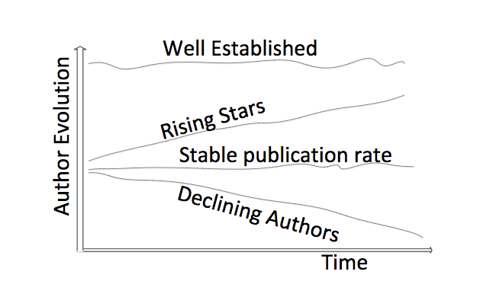
PROBLEM DEFINITION
Analyze the trends and patterns behind KOL
Predict the probability of an individual to be KOL
FIG: Four basic author’s evolution behavior over time (Tsatsaronis et al. 2011)

Slide 3
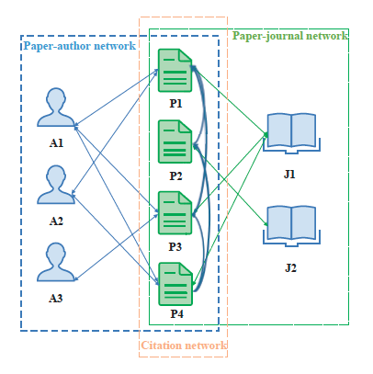
State of Art
PageRank
Supervised Learning
Clustering

Slide 4
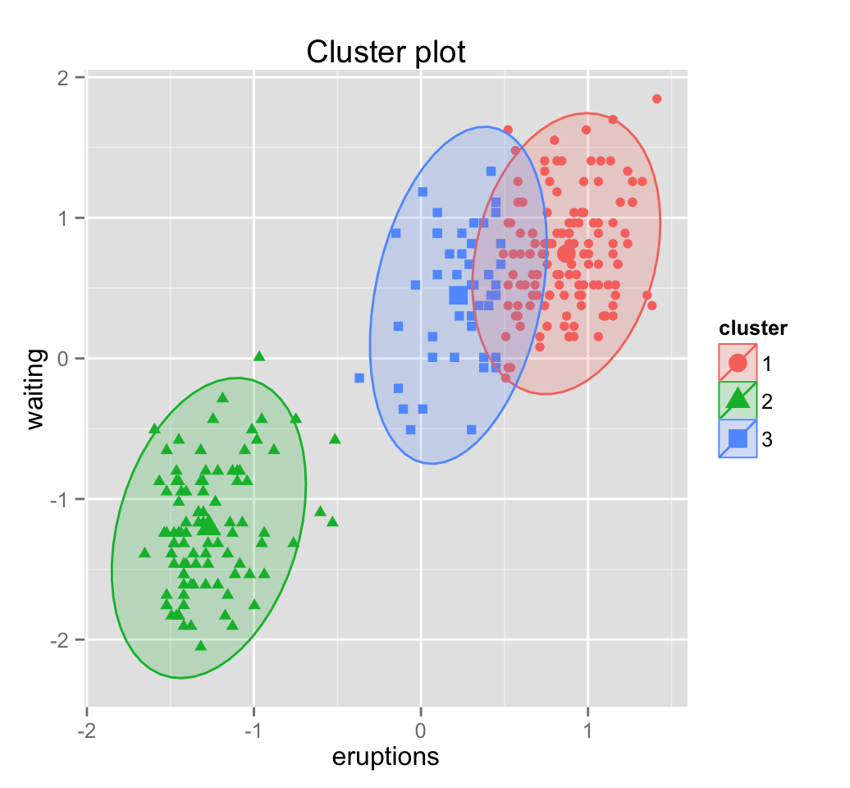
Methodology
Well established
Indices
Rising stars
Absence of manually annotated data
Unsupervised Learning: Clustering
3 steps:
Define features
Monitor the evolution of features
Use these indices to cluster authors
Declining
Time
Notes:
Supervised learning is not applicable due to the absence of manually annotated data(rising stars) for this task

Slide 6
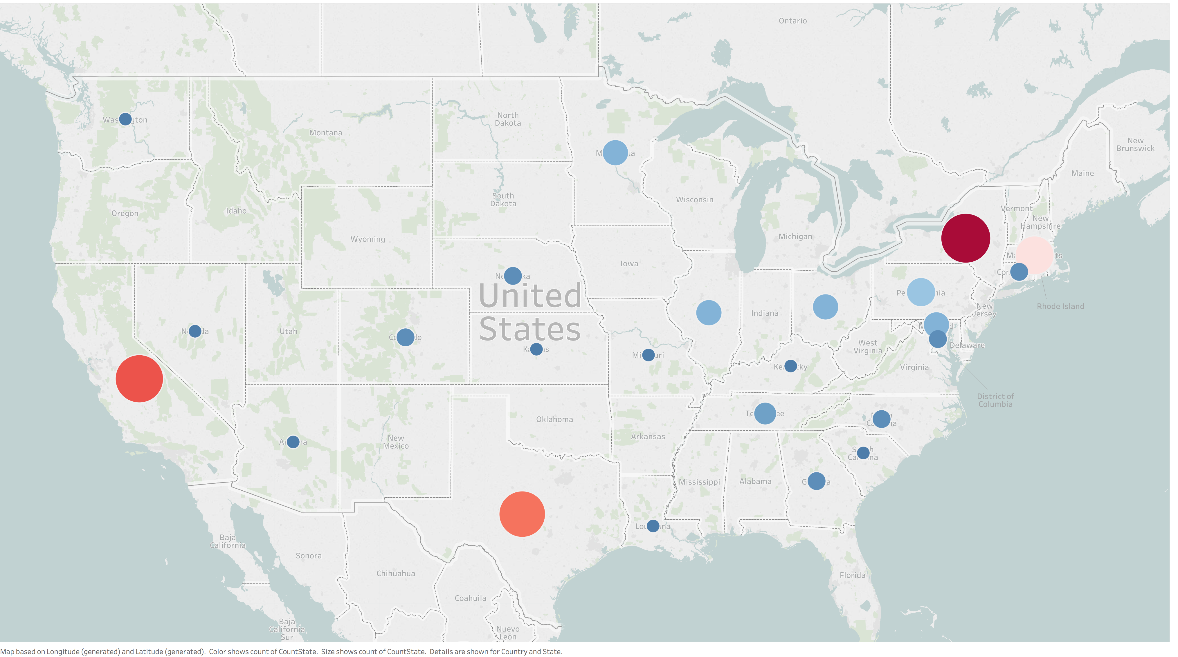
KOL's geographic distribution

Slide 7
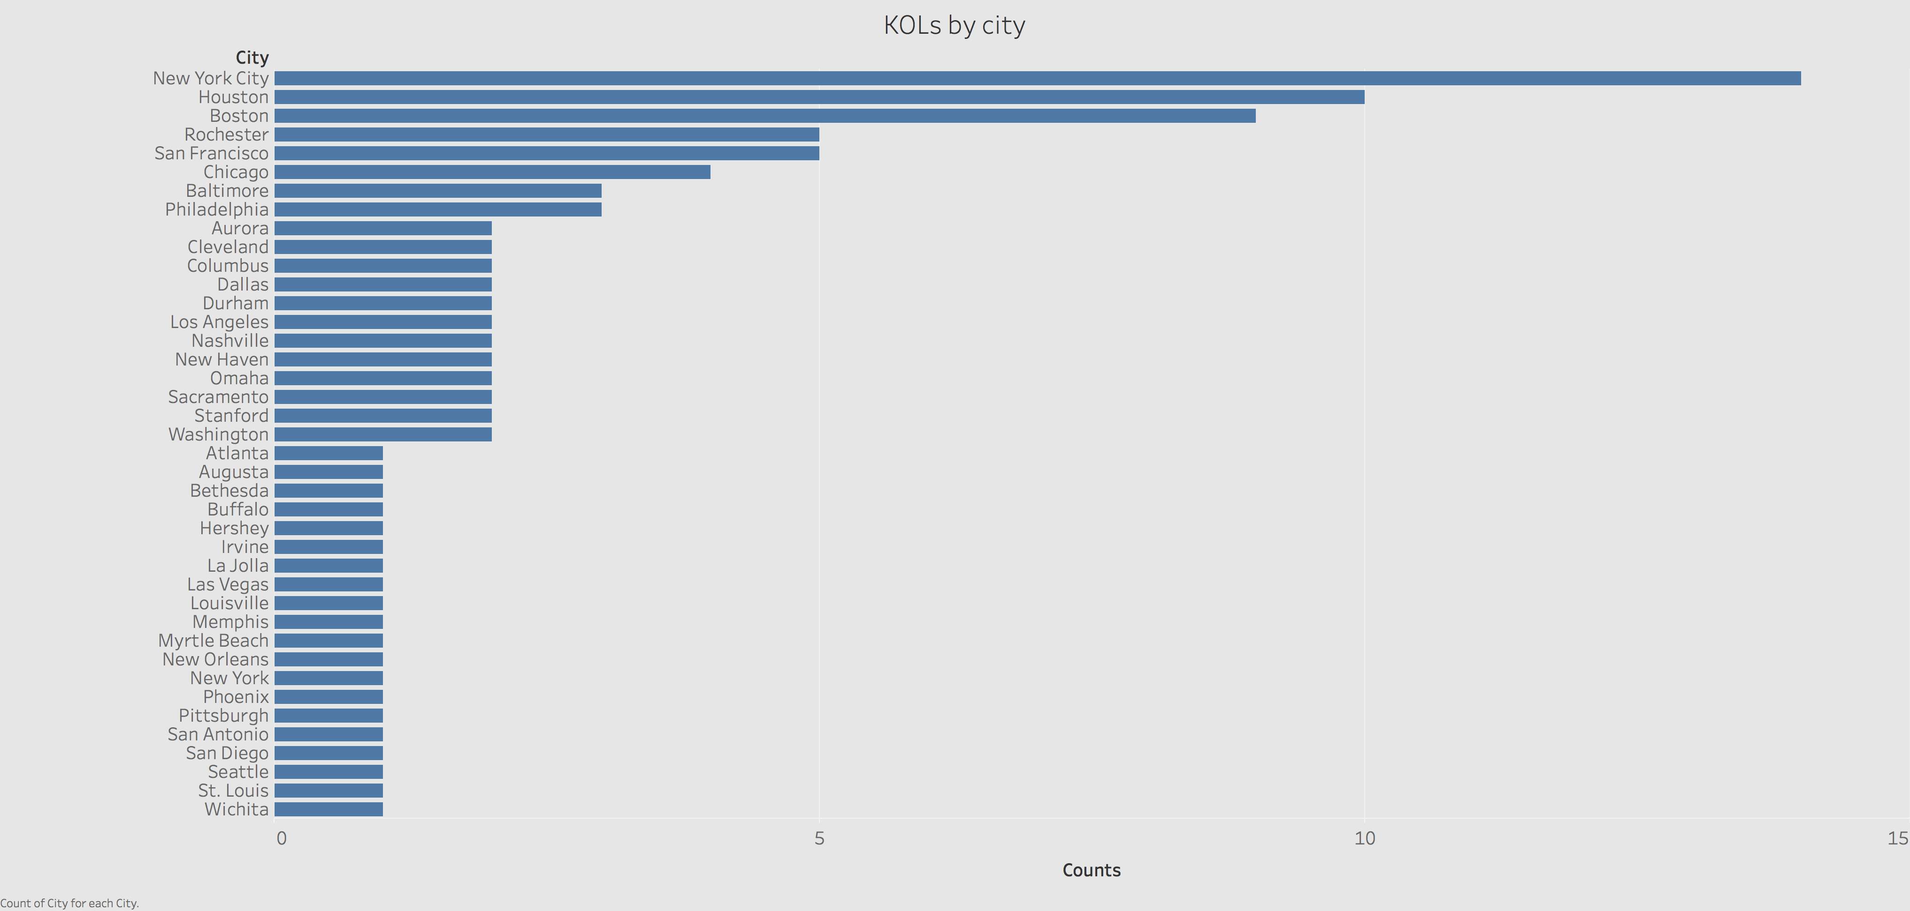

Slide 8
Publication production trend

Slide 9
Publication production stats

Slide 10
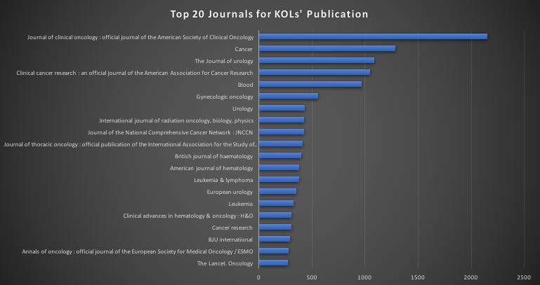
Publication Journals Analysis
Top 20 journals account for 47.50% publications

Slide 11
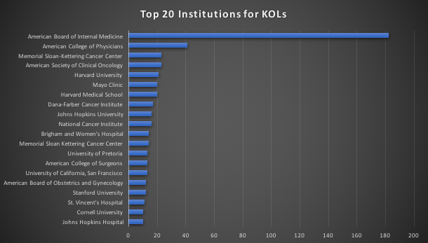
Education Institution Analysis
Top 20 institutions account for 39.67% admissions

Slide 12
Exploratory Data Analysis
Chart to be attached

Slide 13
Exploratory Data Analysis
Chart to be attached

Slide 14
Exploratory Data Analysis
Chart to be attached

Slide 15
Extracting citation information
Why does citation information make sense
Method
Web scraping from Google Scholar
Scopus API
Pubmed
Tech issue

Slide 16
Next steps
Want 100 samples
Feature engineering
Build models
Prediction and validation
Citation(option)
Obtained 100 samples
Want 100 samples
FIG: Four basic author’s evolution behavior over time (Tsatsaronis et al. 2011)

